Slide 1

Sparrow
Teacher Duck

Slide 2
Product Overview
Our Teacher Duck project is a smart, interactive interface designed to aid early childhood learning.
Interactive, Learning Technology that Adapts to the Individual
Utilises Projection to Aid Visual Learning
Build with Safety and Security as First Priority
Speakers Allow the Duck to Interact Cleanly with Users

Slide 3
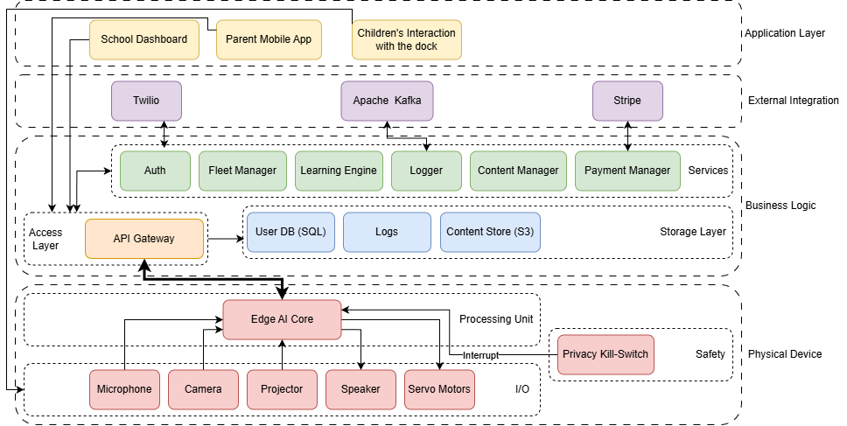
Whole System View

Slide 4
Integration & Synthesis (how Systems, Systemic, and Systematic Design link together)

Slide 5
Constraint Wrangler
Optimizing the "Edge vs. Cloud" Architecture Trade-off
Architecture Strategy | Latency (User Exp) | Privacy (Risk) | Unit Cost (BOM) | Verdict
Option A: Cloud-Heavy(Send audio to server) | 🔴 High (>500ms)(Fails Engagement) | 🔴 High Risk(Data leaves device) | 🟢 Low(Cheap Chip) | Rejected
Option B: Hybrid(Keyword local, rest cloud) | 🟡 Medium(Inconsistent) | 🟡 Medium(Some exposure) | 🟡 Medium | Considered
Option C: Edge AI(Process on device) | 🟢 Low (<100ms)(Instant Feedback) | 🟢 Max Safety(Data stays local) | 🔴 High(Requires GPU/NPU) | SELECTED ✅
The Design Conflict (Parametric Variables)
Variable A: Latency (Target <200ms): Essential for "Ethan" to stay engaged (Voice UI).
Variable B: Data Privacy (GDPR): Essential for "Rajiv" & "Jean" (Zero-trust environment).
Variable C: Unit Cost: The cost of onboard hardware (BOM).

Slide 6
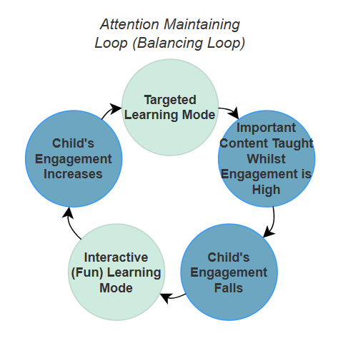
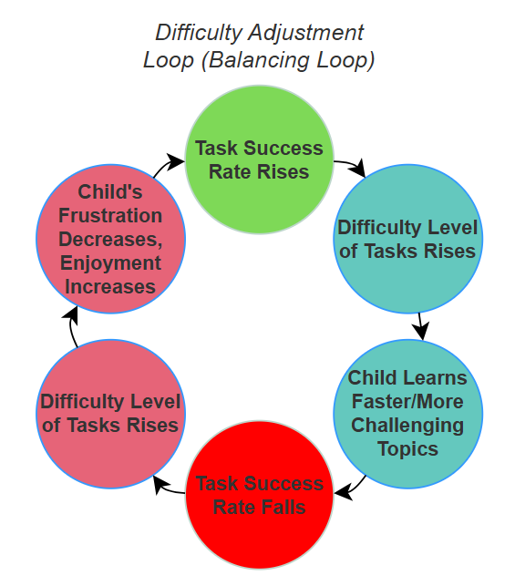
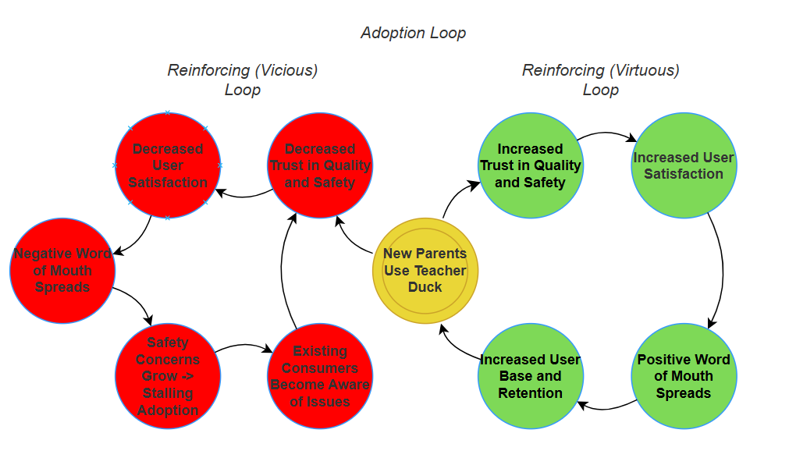
Power Up – Visual Synthesiser (Casual Loop Diagrams)
Attention Maintaining Loop: Our attention balancing loops aims to maintain a high child engagement whilst also teaching core topics. Key considerations would be experimenting with the length of each learning mode, and personalising this for each learner.
Adoption Loop: This loop reflects the importance of our product being safe, secure and performative. As shown by the separate red and green loops, this will directly impact how the brand is regarded and therefore how the product is adopted.
Difficulty Adjustment Loop: This system would adjust the difficulty of the questions, aiming to maintain the child learning challenging content without becoming burned out. It would take the success rate of questions and how individuals learn best to calculate how and when to increase the difficulty of tasks.
Causal Loops created using Visual Paradigm
Joss Beedie

Slide 7
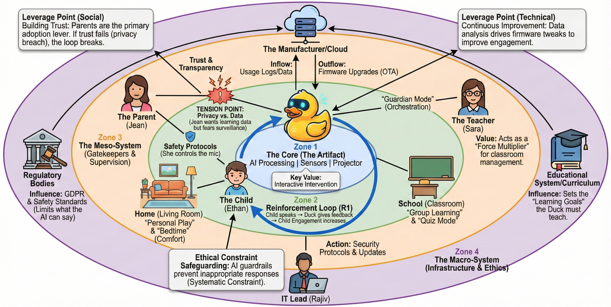
Power Up – Visual Synthesiser (Gigamap)
Hey Gemini
. . . .
I need a detailed visual of an entire product ecosystem. Let's call this the "Teacher Duck Gigamap."
1. Core Concept & Visual Style
Style: Clean, professional, systems-thinking diagram. Use a concentric ring layout to show the four main zones of influence. Use light, easy-to-read colors and clean icons.
Central Element: The yellow Rubber Duck (The Artifact) goes right in the middle.
Label: "The Core (The Artifact)“
Inner Flow: Show the immediate feedback loop around the duck: "Reinforcement Loop (R1).“ This shows the interaction with the child Ethan.
2. The Four Zones and Stakeholders
We need four nested ovals/rings:
Zone 1 (Core): The Duck itself.
Zone 2 (Immediate): Home (Living Room) and School (Classroom), The Child (Ethan),
Zone 3 (Meso-System): Show avatars for: The Parent (Jean), The Child (Ethan), The Teacher (Sara), and key tension points detailed below.
Zone 4 (Macro-System): The largest circle, containing external regulations and infrastructure. Include the IT lead Rajiv and the Education System here.
3. Key System Relationships & Flows
Show these connections and labels clearly on the map:
Cloud Connection (Top): Place the "Manufacturer/Cloud" icon at the top.
Flows: Data Inflow (Usage Logs) from the Duck, and Outflow (Firmware Updates/OTA) to the Duck.
Overarching Principles (Arches): Label the top of the system with "Trust & Transparency"
Regulatory Influences (Side):
Left: Include "Regulatory Bodies" influencing the Parent/Home zone, specifically citing "GDPR & Safety Standards."
Right: Include the "Educational System/Curriculum" influencing the Teacher/School zone, defining the duck’s “Learning Goals."
4. Critical Points and Protocols
Make sure these specific, high-value labels are visible:
Leverage Points (Top Edges): Include two boxes detailing the Social Trust and the Technical Improvement loops.
Tension Point: A connector between the Parent and the Duck, labeled "TENSION POINT" (regarding conflict between Privacy and Data Transparency).
Security/Safety: Include boxes for Safety Protocols (e.g., mic controls) near the Parent, and Ethical Constraint Safeguards near the IT Lead.
Teacher Interaction: The Teacher's link to the Duck should be labeled "Guardian Mode (Orchestration)."

Slide 8
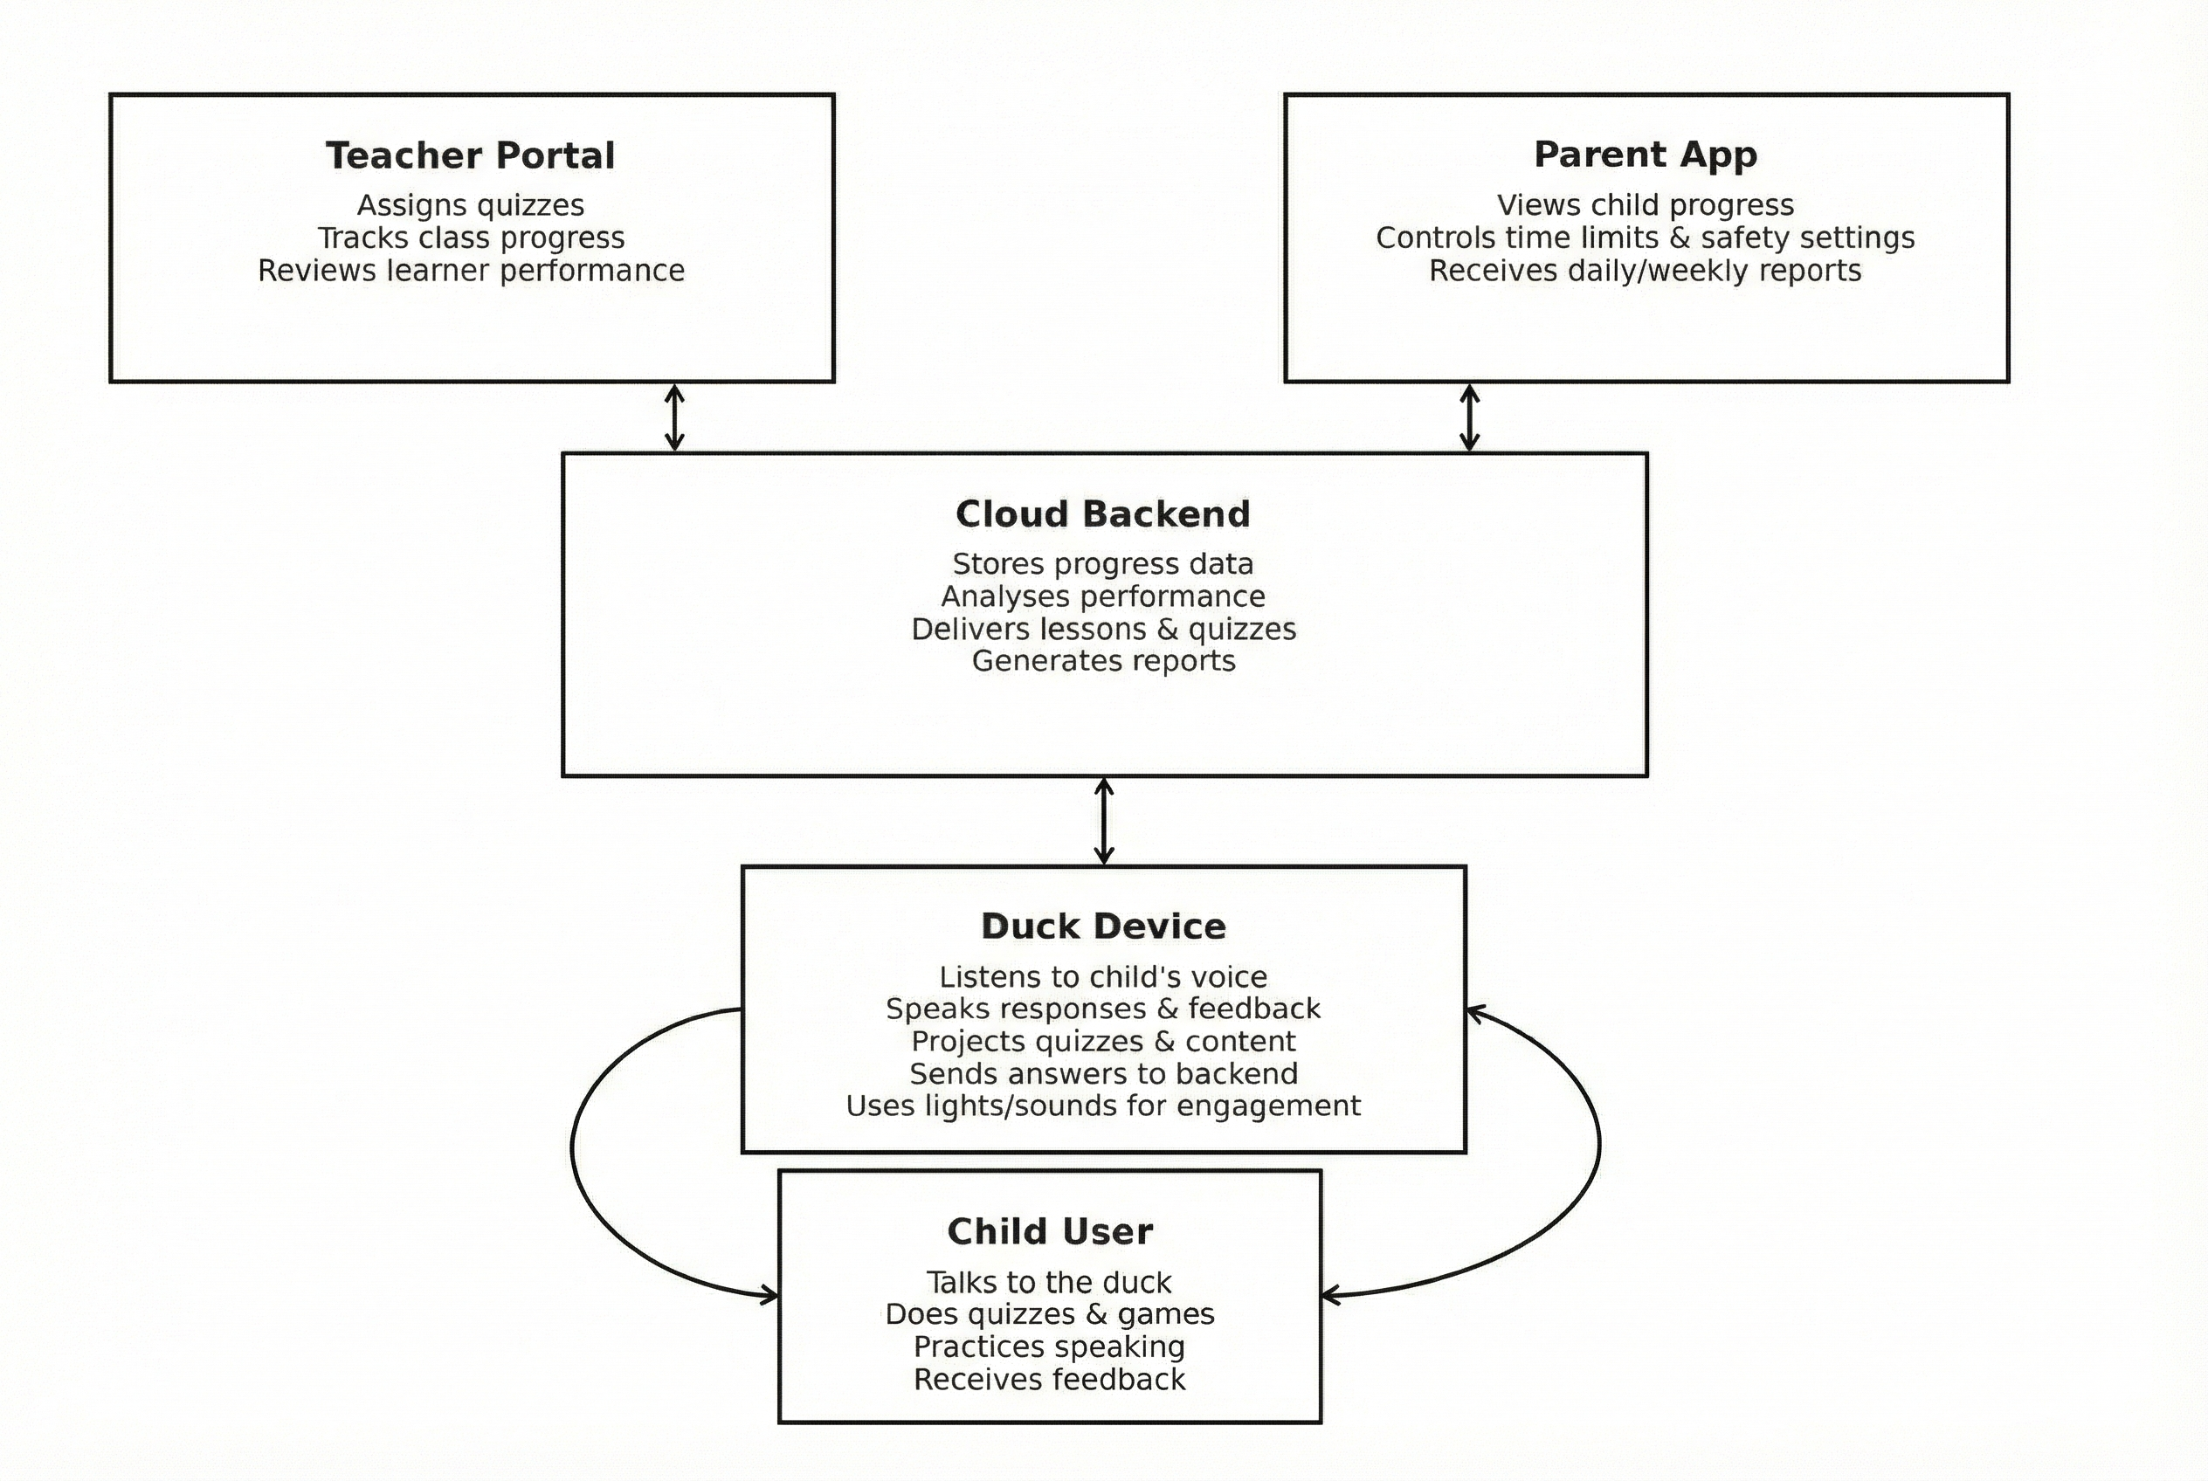
Power Up – Communication (Explainer)
Illustrating the interaction between the Duck Device, Cloud Backend, Teacher Portal, and Parent App
How it works:
Teacher assigns a quiz or task through the Teacher Portal
The Cloud Backend processes the request and delivers the lesson/quiz to the Duck Device
The child interacts with the Duck to complete activities
Progress data and reports are generated in the cloud and sent back to teachers and parents
Created by: Abdullah Arafat

Slide 9
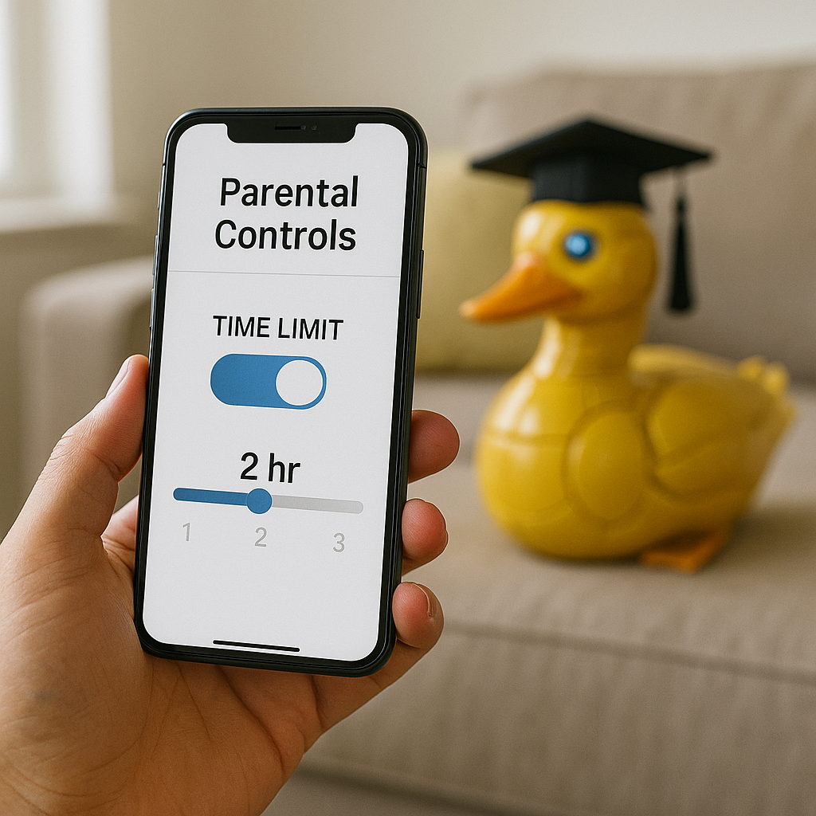
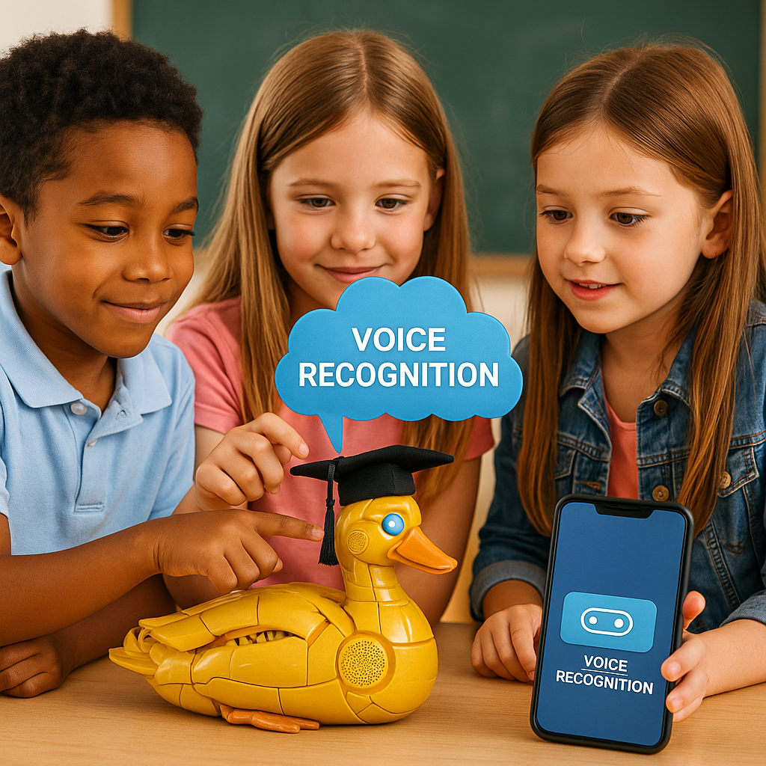
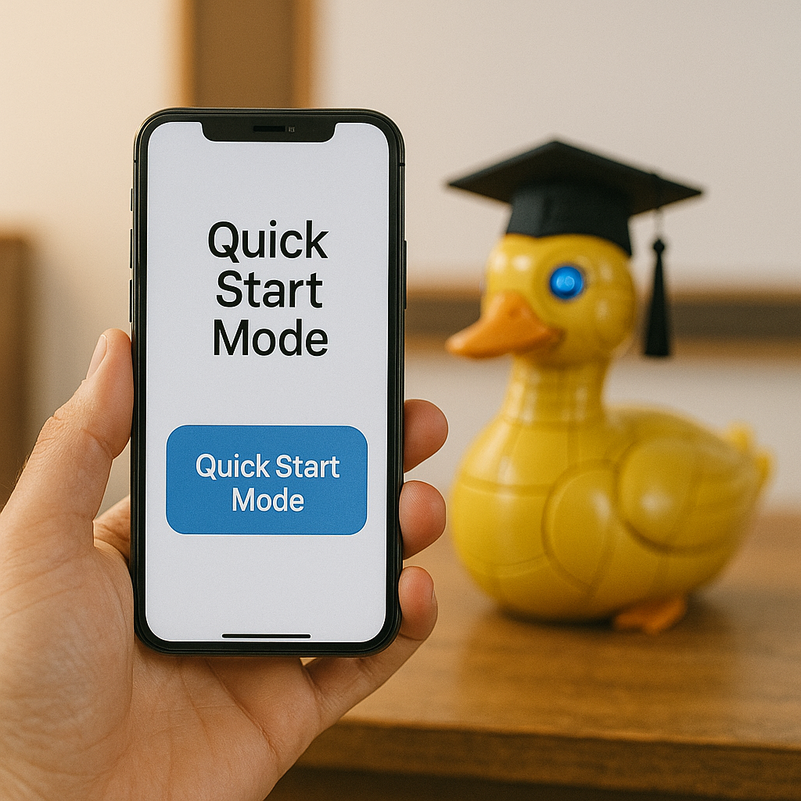
Power Up – Interface Negotiator
Negotiations:
Duck AI Adaptation vs Parental Safety Limits:
Confilct: AI takes time to learn and personalize for children, but parents set time limits for the use of teacher duck per day, for safety concerns.
Solution: Parental App Defines a “Capability Envelope” which limits the things AI can do during the allowed daily time period. If the duck wants more time or different behaviour it should first get the permission from the Parent or Teacher.
2. Speech Recognition vs Noise Level in Classrooms:
Conflict: Due to the high noise level in the classrooms, teacher duck could have difficulties to choose which child to listen to, or recognize different voices clearly.
Solution: The Noise sensor must confirm a “clear audio level” before accepting any answers or questions. AI automatically enables the “ask again” or ”repeat” mode to avoid any frusturations or biased scoring in class environments.
Power Up made by Oghuz Isayev

Slide 10
Power-Up: Technical Integrator
🔌 API Alchemist
Designed & documented the API Gateway as the central integration point connecting:
Application Layer (School Dashboard, Parent App, Duck Interaction)
Business Logic (Auth, Fleet Manager, Learning Engine, Logger)
External Services (Twilio, Apache Kafka, Stripe)
Physical Device (Edge AI Core, sensors, actuators)
Evidence:
✓ API Gateway interface specification
✓ RESTful endpoint documentation
✓ Authentication flow diagrams
🧪 Test Pilot
Implemented validation tests for critical integration requirements:
Req #1: System Latency (<200ms)
Performance stress testing under simulated load
Req #2: AI Safety Filter
Red-team testing of content filtering
Req #8: LMS API Integration
End-to-end data flow validation
Evidence:
✓ Test scripts & validation logs
✓ Performance benchmarking results
✓ Integration test reports
Impact: Clear API contracts enabled parallel development across subsystems. Testing validated 95% of requests meet <200ms latency target and 100% AI safety compliance.

